Slide 1
Final Project Presentation
Jay Pointer
http://www.jpgamesdesign.co.uk/

Slide 2
Why I chose to do this
Main Article I looked was By Joel Burgess
He was one of the developers of Elder Scrolls: Skyrim
Talks about the Art Fatigue in Oblivion when they recreated many dungeons

Slide 3
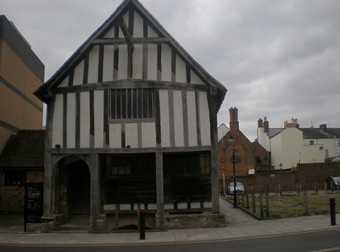
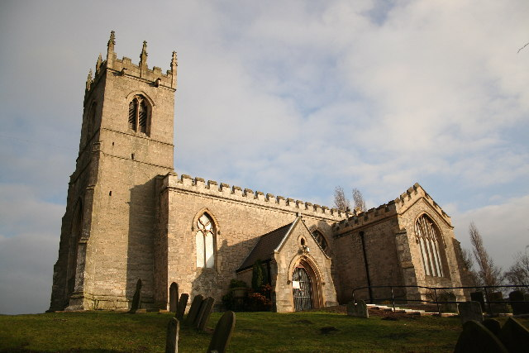
Building Research
Focus on Wooden Beam structures on the houses
White Stone Walls
Stone church walls
May be slightly similar to each other due to the design

Slide 4
What I’ve done so far…

Slide 5
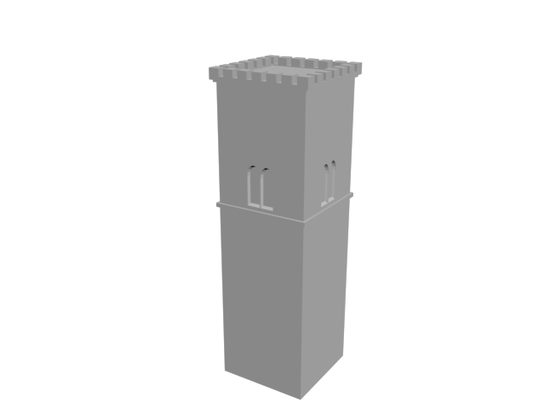
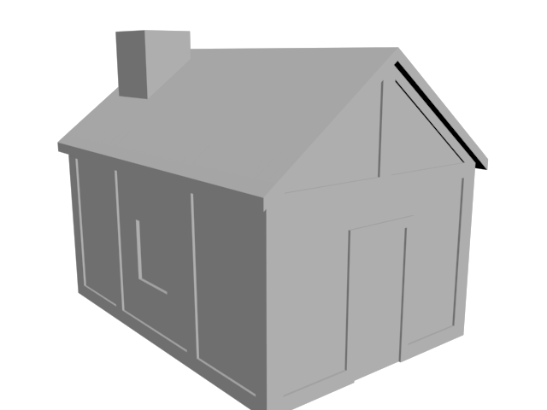
Buildings
Church steeple with the top and 4 windows
Entire small house

Slide 6
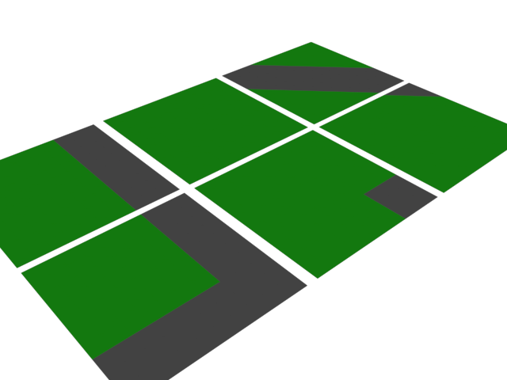
Tiles
Road tiles have now been marked out
To be textured next…
One more tile yet to be done

Slide 7
My Plan from here…

Slide 8
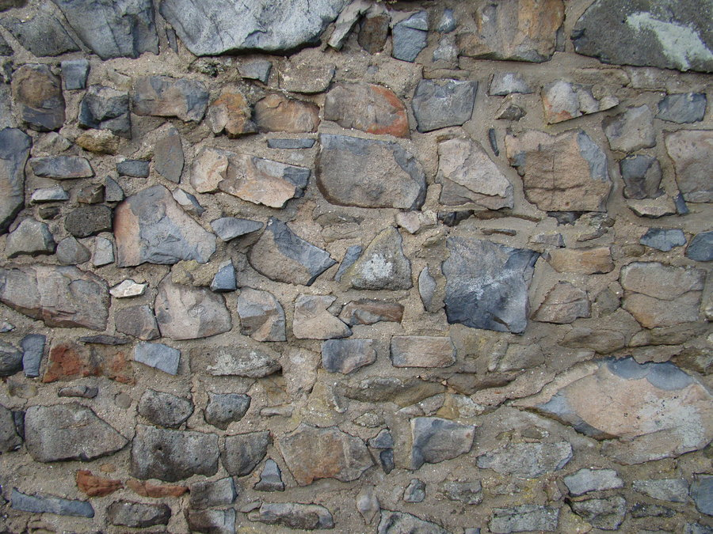
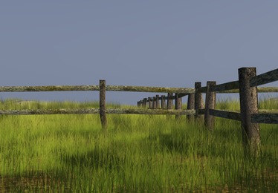
Dividers
Small Pieces to break up the empty land
Stone Walls
Props

Slide 9
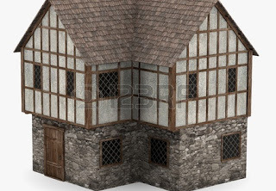
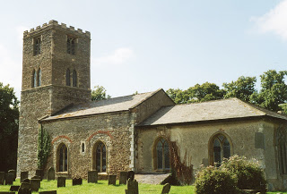
Building Meshes
Finish the main part of the church
Create the Large House
Reference Images →

Slide 10
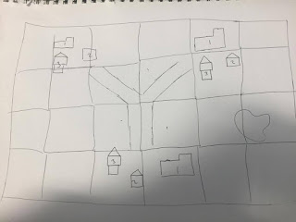
Map Layout
Start to plan out prop placement
Start to compile the map as I complete assets

Slide 11
Questions?

